Slide 1
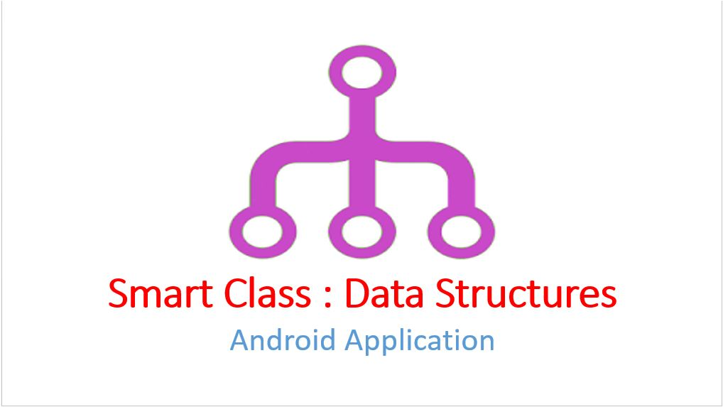

Slide 2
Contents:
Introduction
Overview
purpose
Motivation
Overall Description
Version Compatibility
Working
Key Features
Advantages
Future Scope
references

Slide 3
Introduction:
What is Smart Class ?
Smart Class is an Android application developed for students, considering perspective of simplifying the learning of core subjects. The moto behind developing this application is to provide students a unique platform to access every bit of data regarding particular subject.
In this application, we have focused on most essential subject of Computer Science , i.e. , Data Structures.

Slide 4
Purpose
The simple and noble aspiration behind the Smart Class application is to enhance the way of user friendly learning for the students by presenting the basic concepts of data structures in simple, easy and efficient way.
Reason behind choosing android as a platform is, it is an open source and most widely (75%-80%) used Mobile OS.
Motivation
As the complexity level of the problems increases, it becomes more difficult for the students to visualize and understand the things. Hence to visualize the students the actual constructs of data structures, the Smart Class application has a vital role in the learning process.

Slide 5
Overall Description
Version Compatibility
Smart Class application is compatible within the wide range of Android versions ranging from 4.2.2 ( sdk version 14) to 6.0 ( sdk version 23).
Development Tool
Android Studio 1.4.1 and 1.5

Slide 6
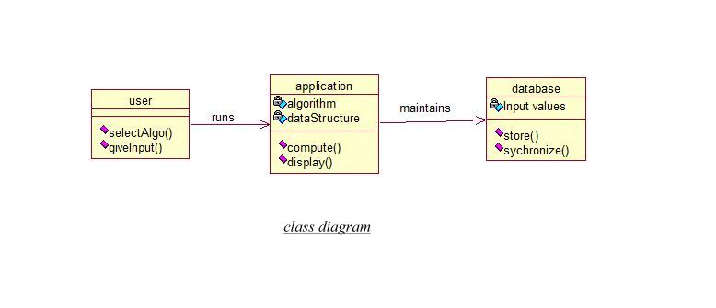
UML DIAGRAMS

Slide 7
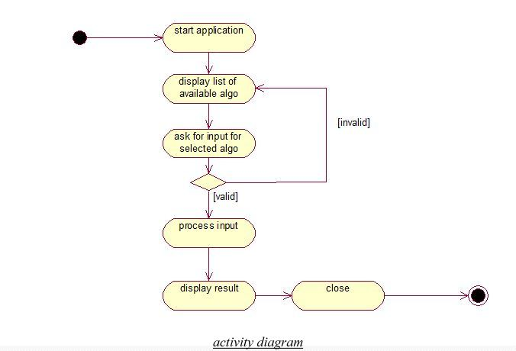

Slide 8
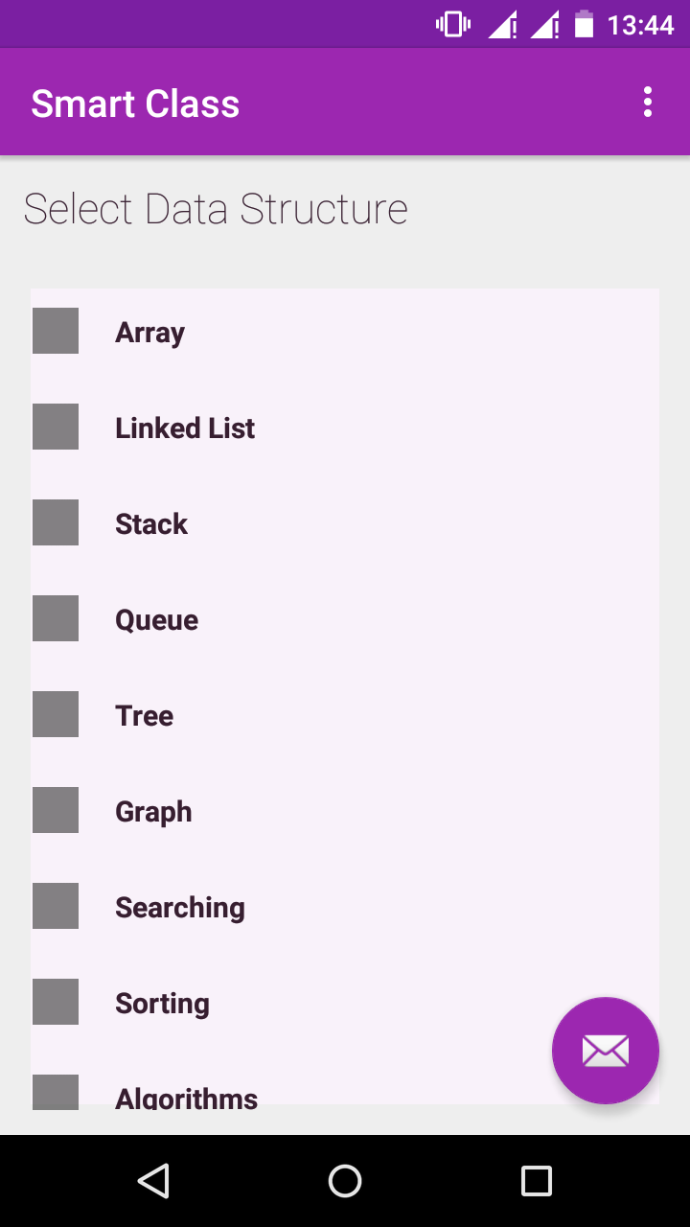
Working
The Smart Class Application covers the basics of Data Structures.
The main activity of Smart Class includes expandable view listing different types of Data Structures.

Slide 9
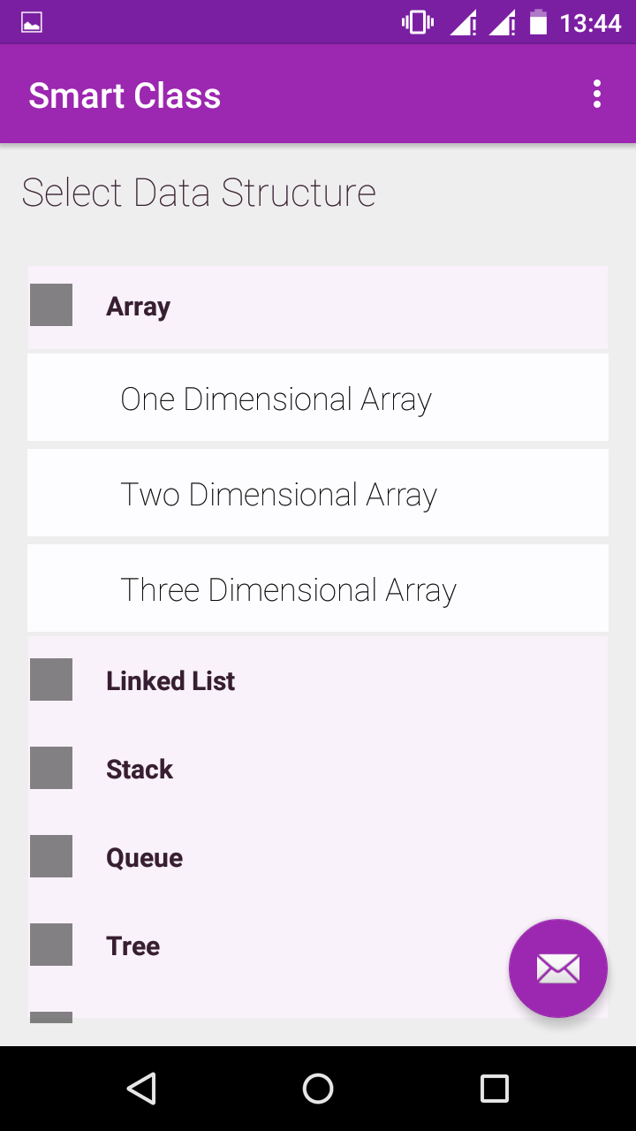
Dropdown view enlists the subtypes of the corresponding main Data Structure.

Slide 10
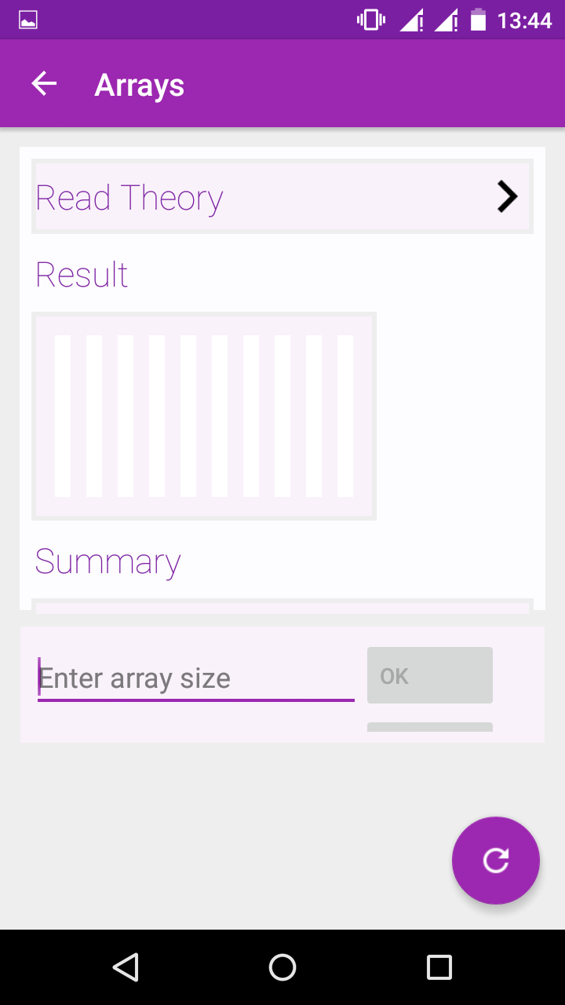
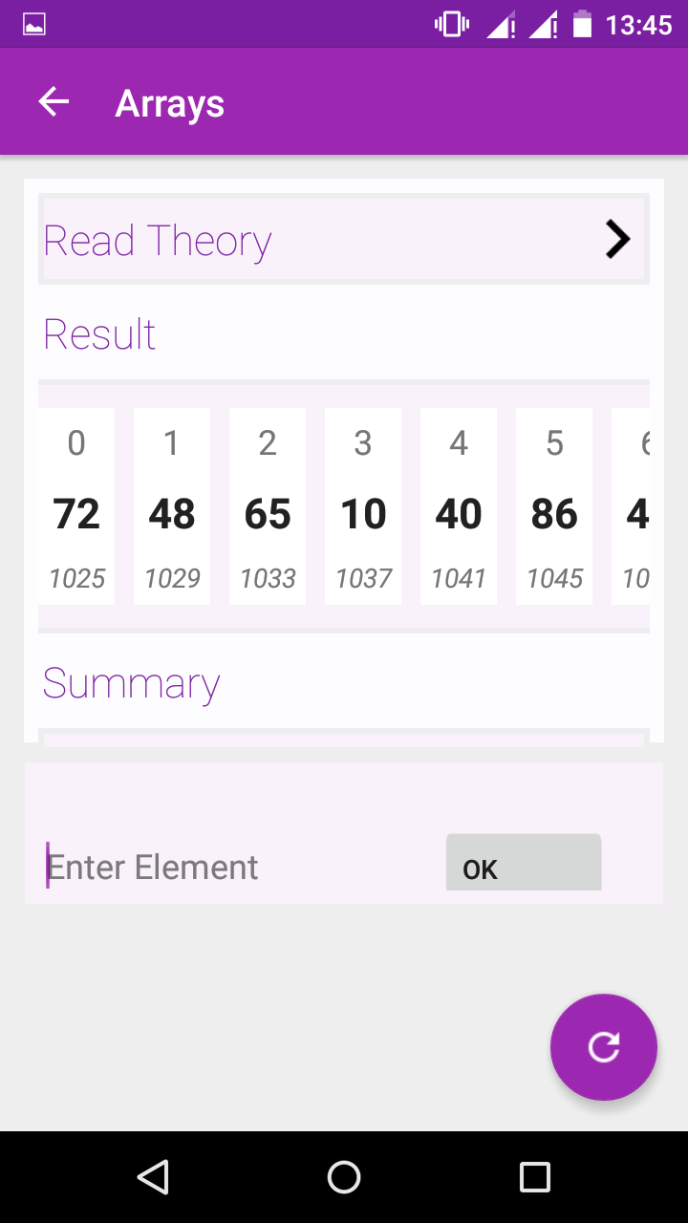
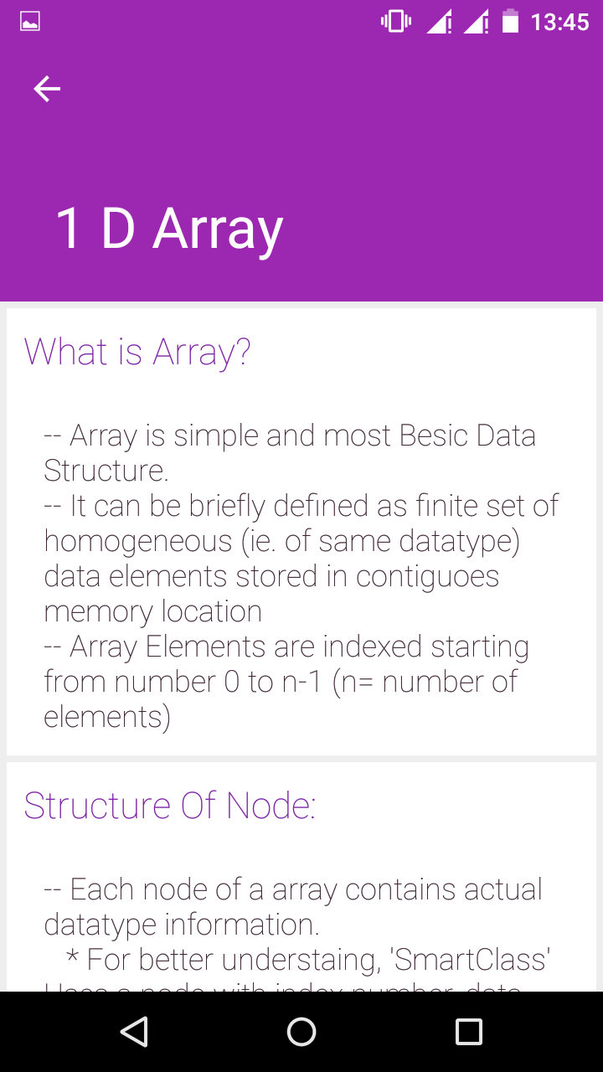
One Dimensional Array Activity

Slide 11
Key Features
Google standards for android application development are followed.
While designing the User Interface we have followed the Material Design guidelines.

Slide 12
Advantages:
Most of the Students use Android OS based System.
All the details a student desires to know about Data Structures are enclosed into the Smart Class Application.
Visualization of complex structures made easy
Learning process is simplified

Slide 13
Future Scope
Animations can be improved.
In read theory activity, objective type questions can be included.
More complex data structural elements can be included.

Slide 14
THANK YOU !

